Slide 1
Pattern
C Programming Language

Slide 2
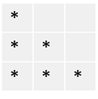
Code :
Pattern Type- 01
(Right angle triangle Pattern)
1
1 | 2
1 | 2 | 3
1
1 | 0
1 | 0 | 1
A
A | B
A | B | C
#include <stdio.h>
#include <stdlib.h>
int main()
{
int n,row,col ;
scanf("%d",&n);
for( row = 1 ; row<=n ; row++)
{
//space
for( col = 1 ; col<=n-row ; col++)
{
printf(" ");
}
for( col = 1 ; col<=row ; col++)
{
printf("%d ",col);
}
printf("\n");
}
for( row = n-1 ; row>=1 ; row--)
{
for( col = 1 ; col<=n-row ; col++)
{
printf(" ");
}
for( col = 1 ; col<=row ; col++)
{
printf("%d ",col);
}
printf("\n");
}
return 0;
}
1
2 | 2
3 | 3 | 3
1
0 | 0
1 | 1 | 1
A
B | B
C | C | C
#
# | #
# | # | #
Number
pattern
Binary
pattern
Character
pattern
Special character pattern

Slide 3
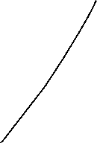

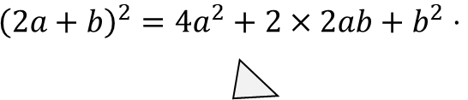

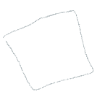





4x2+6xy+6xy+9y2
=4x²+12xy+9y²
=4x²+12xy+9y²
$${\left(2a+b\right)}^{2}=4a^{2}+2×2ab+b^{2}⋅$$

